Slide 1
Implementing Data Security Week 9
Submitted by,
Basavraj Jaliminche 8800149
Veera Venkata Raghuveer Babu Reddy - 8801135
Rohit Arora 8786754
Nachiket Solanki 8799955

Slide 2
Application Vulnerabilities
Application vulnerabilities are defects or weaknesses that could allow for exploitation or a security breach in an application.
Web applications are particularly vulnerable to attack because of the Internet's extensive worldwide reach. Attacks can originate from numerous places using a variety of attack vectors.
Any web application security programme must include control of application vulnerabilities and application security testing.
Injection: Injection flaws, such as SQL, NoSQL, OS, and LDAP injection, occur when untrusted data is sent to an interpreter as part of a command or query. The attacker’s hostile data can trick the interpreter into executing unintended commands or accessing data without proper authorization.
Broken Authentication: Application functions related to authentication and session management are often implemented incorrectly, allowing attackers to compromise passwords, keys, or session tokens, or to exploit other implementation flaws to assume other users’ identities temporarily or permanently.
Sensitive Data Exposure: Many web applications and APIs do not properly protect sensitive data, such as financial, healthcare, and Personally Identifiable Information. Attackers may steal or modify such weakly protected data to conduct credit card fraud, identity theft, or other crimes. Sensitive data may be compromised without extra protection, such as encryption in storage or in transit, and requires special precautions when exchanged with the browser.
XML External Entities (XXE): Many older or poorly configured XML processors evaluate external entity references within XML documents. External entities can be used to disclose internal files using the file URI handler, internal file shares, internal port scanning, remote code execution, and denial of service attacks.

Slide 3
XML External Entities (XXE): Many older or poorly configured XML processors evaluate external entity references within XML documents. External entities can be used to disclose internal files using the file URI handler, internal file shares, internal port scanning, remote code execution, and denial of service attacks.
Security Misconfiguration: Security misconfiguration is the most commonly seen issue. This is commonly a result of insecure default configurations, incomplete or ad hoc configurations, open cloud storage, misconfigured HTTP headers, and verbose error messages containing sensitive information. Not only must all operating systems, frameworks, libraries, and applications be securely configured, but they must be patched/upgraded in a timely fashion.
Cross-Site Scripting XSS: XSS flaws occur whenever an application includes untrusted data in a new web page without proper validation or escaping, or updates an existing web page with user-supplied data using a browser API that can create HTML or JavaScript. XSS allows attackers to execute scripts in the victim’s browser which can hijack user sessions, deface web sites, or redirect the user to malicious sites.
Insecure Deserialization: Insecure deserialization often leads to remote code execution. Even if deserialization flaws do not result in remote code execution, they can be used to perform attacks, including replay attacks, injection attacks, and privilege escalation attacks.
Using Components with Known Vulnerabilities: Components, such as libraries, frameworks, and other software modules, run with the same privileges as the application. If a vulnerable component is exploited, such an attack can facilitate serious data loss or server takeover. Applications and APIs using components with known vulnerabilities may undermine application defenses and enable various attacks and impacts.
Using Components with Known Vulnerabilities: Components, such as libraries, frameworks, and other software modules, run with the same privileges as the application. If a vulnerable component is exploited, such an attack can facilitate serious data loss or server takeover. Applications and APIs using components with known vulnerabilities may undermine application defenses and enable various attacks and impacts.

Slide 4
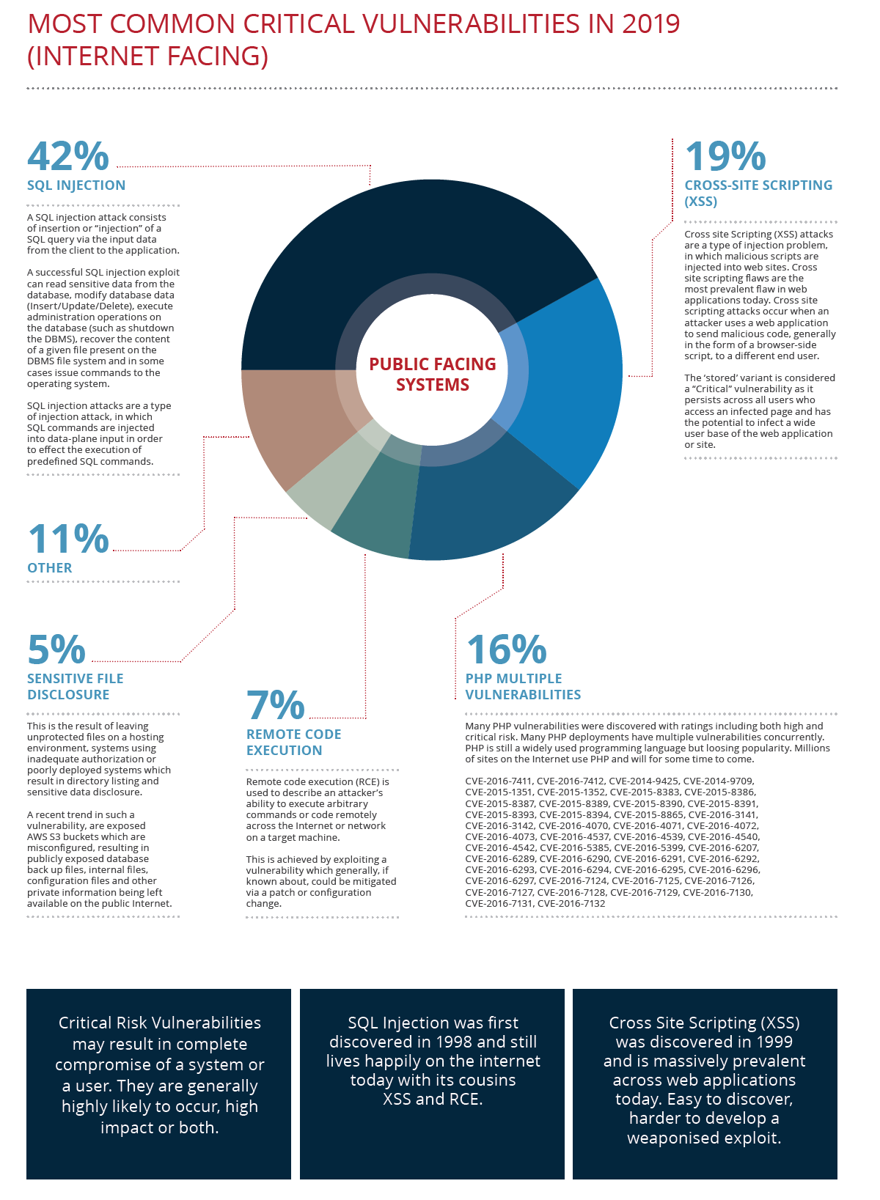
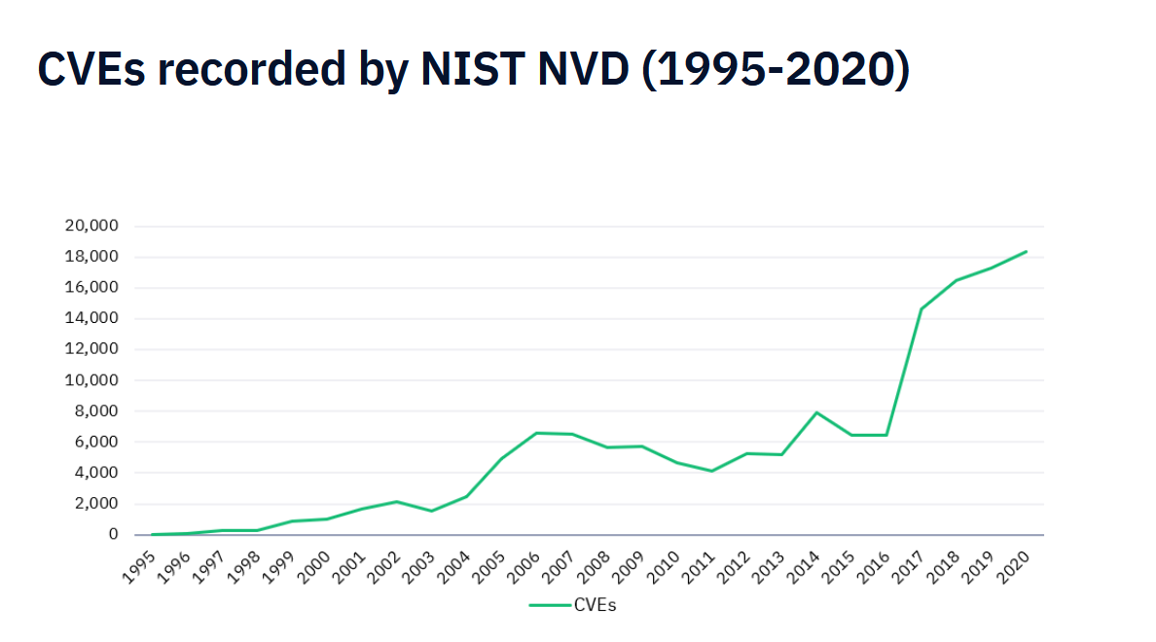
Most Common Critical Vulnerabilities
Retrieved from : https://www.google.com/url?sa=t&rct=j&q=&esrc=s&source=web&cd=&ved=2ahUKEwiK6dD3ssryAhUMCc0KHWElC2cQFnoECBIQAQ&url=https%3A%2F%2Fcdn2.hubspot.net%2Fhubfs%2F4118561%2FBCC030%2520Vulnerability%2520Stats%2520Report%2520(2020)_WEB.pdf&usg=AOvVaw0iPvVm6iOMk_f987jtkDe1 , Online; Accessed: August 24th, 2021
Retrieved from: https://www.redscan.com/news/nist-nvd-analysis/, Online, Accessed: August 24th, 2021

Slide 5
Database Security
What are the ways in which we can secure the databases that contain data (for our applications)?
User accounts. When you create user accounts, you can secure them in a variety of ways. You can also create password profiles to better secure password policies for your site.
Authentication methods. Oracle Database provides several ways to configure authentication for users and database administrators. For example, you can authenticate users on the database level, from the operating system, and on the network.
Privileges and roles. You can use privileges and roles to restrict user access to data.

Slide 6
Application security. The first step to creating a database application is to ensure that it is properly secure.
User session information using application context. An application context is a name-value pair that holds the session information. You can retrieve session information about a user, such as the user name or terminal, and restrict database and application access for that user based on this information.
Database access on the row and column level using Virtual Private Database. A Virtual Private Database policy dynamically imbeds a WHERE predicate into SQL statements the user issues.
Classify and protect data in different categories. You can find all table columns in a database that hold sensitive data (such as credit card or Social Insurance Numbers), classify this data, and then create a policy that protects this data as a whole for a given class.
Network data encryption. Manually encrypting data, using the DBMS_CRYPTO PL/SQL package to encrypt data as it travels on the network to prevent unauthorized access to that data. You can configure native Oracle Net Services data encryption and integrity for both servers and clients.
Thin JDBC client network configuration. You can configure thin Java Database Connectivity (JDBC) clients to securely connect to Oracle databases.

Slide 7
Strong authentication. You can configure your databases to use strong authentication with Oracle authentication adapters that support various third-party authentication services, including SSL with digital certificates. Oracle Database provides the following strong authentication support:
Centralized authentication and single sign-on.
Kerberos
Remote Authentication Dial-in User Service (RADIUS)
Secure Sockets Layer (SSL)
Auditing database activities. You can audit database activities in general terms, such as auditing all SQL statements, SQL privileges, schema objects, and network activity. Or, you can audit in a granular manner, such as when the IP addresses from outside the corporate network is being used.

Slide 8
Handling Password / Text Input
Design applications to interactively prompt for passwords. For command-line utilities, do not force users to expose passwords at a command prompt.
Check the APIs for the programming language you use to design applications for the best way to handle passwords from users.
Protect your database against code injection attacks. Code injection attacks most commonly occur in the client application tool that sends SQL to the database (for example, SQL*Plus, or any Oracle Call Interface (OCI) or JDBC application. This includes database drivers that are built using these tools. A SQL injection attack causes SQL statements to behave in a manner that is not intended by the PL/SQL application. The injection attack takes place before the statement is sent to the database. For example, an intruder can bypass password authentication by setting a WHERE clause to TRUE.
To address the problem of SQL injection attacks, use bind variable arguments or create validation checks. If you cannot use bind variables, then consider using the DBMS_ASSERT PL/SQL package to validate the properties of input values

Slide 9
If possible, design your applications to defer authentication and use certificates for logins. Also, authenticate users by using facilities provided by the operating system. For example, applications on Microsoft Windows can use domain authentication.
Mask or encrypt passwords. If you must store passwords, then mask or encrypt them. For example, you can mask passwords in log files and encrypt passwords in recovery files.
Authenticate each connection. For example, if schema A exists in database 1, then do not assume that schema A in database 2 is the same user. Similarly, the local operating system user bsmith is not necessarily the same person as remote user bsmith.
Do not store clear text passwords in files or repositories. Storing passwords in files increases the risk of an intruder accessing them.
Use a single master password. For example: You can grant a single database user proxy authentication to act as other database users. In this case, only a single database password is needed. See Proxy User Accounts and the Authorization of Users to Connect Through Them for more information. You can create a password wallet, which can be opened by the master password. The wallet then contains the other passwords.

Slide 10
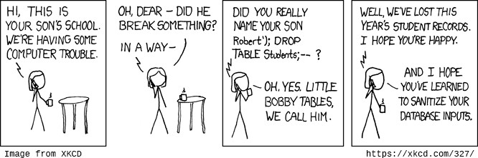
SQL INJECTION
SQL Injection attacks provide a direct interface into the database in the backend
Caused by a lack of input validation
Attack executes arbitrary SQL statements in the backend
database

Slide 11
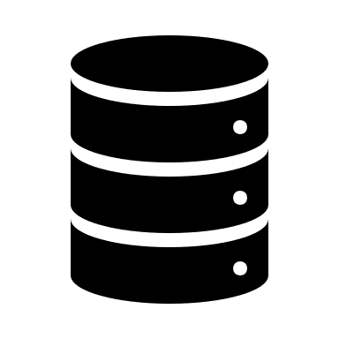



SQL INJECTION
(Web) Applications communicate with databases through SQL to perform CRUD operations on the data
Malicious SQL queries can be “injected” through standard input fields to provide malicious users with access to the data in the database
Can come in the form of URL Parameters, data from web forms, database data.
Need to protect sensitive information in any setting

Slide 12

SQL INJECTON ATTACKING
Username: admin') --
Password: {single space}
The double dashes will comment out anything succeeding it (i.e. bypassing the password)
<form action="/cgi-bin/login" method=post>
Username: <input type=text name=username>
<p>
Password: <input type=password name=password>
<p>
<input type=submit value=Submit>
username=user&password=password

Slide 13
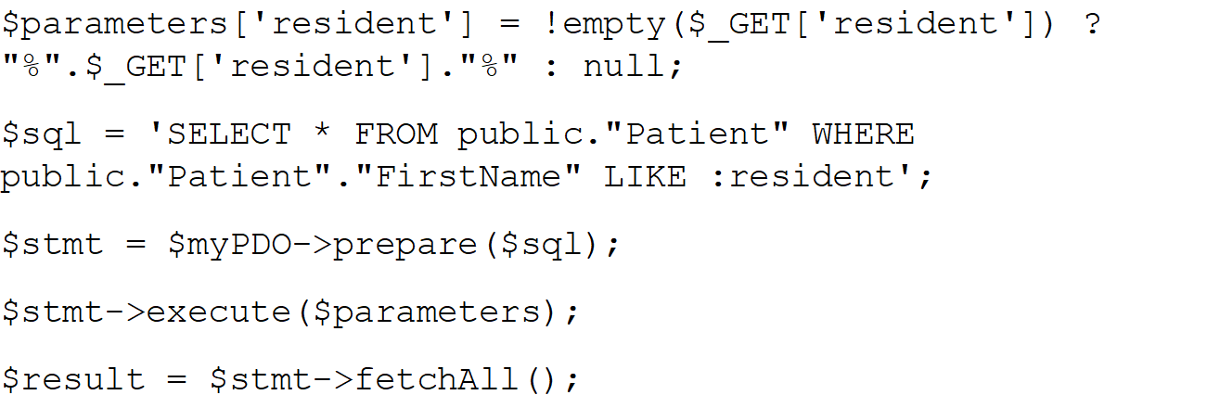
SQL INJECTION PREVENTING
Validation of user input (to prevent special characters)
Parameterizing queries
Using prepare and execute statements
userid = 'Megan'
cur.execute('SELECT * FROM public."Patient" WHERE public."Patient"."FirstName" = %s',(userid,))

